Slide 1
WCCUSD Covid/Physical Safety Overview
West Contra Costa Unified School District
Michael M Booker Sr.
Safety Chief/Consultant
Michael.Booker@WCCUSD.net
(510) 335-1119

Slide 2
Overview
West Contra Costa Unified School District’s plan for the return to school focuses on the health and safety of all staff and students. We have implemented updated CDPH guidance and best practice physical safety strategies. All Covid measures taken are in accordance with the California Department of Public Health (CDPH).

Slide 3
S.M.A.R.T.E.R STRATEGY
Shots- Vaccines are the most powerful weapon against hospitalization and serious illness.
Masks- Properly worn masks with good filtration help slow the spread of COVID-19 or other respiratory viruses.
Awareness- We will continue to stay aware of how COVID-19 is spreading, evolving variants, communicate clearly how people should protect themselves, and coordinate our state and local government response.
Readiness- COVID-19 isn’t going away and we need to be ready with the tools, resources and supplies we will need to quickly respond and keep public health and the health care system well prepared.
Testing- Getting the right type of tests - PCR or antigen - to where they are needed most. Testing will help California minimize the spread of COVID-19.
Education- California will continue to work to keep schools open and children safely in classrooms for in-person instruction.
Rx- Evolving and improving treatments will become increasingly available and critical as a tool to save lives.
CDPH Guidance 6/30/22

Slide 4
COVID RESOURCES
COVID QUICK GUIDE SHEET

Slide 5
MASKING GUIDANCE:
Face Coverings: All employees and students are strongly recommended to wear approved masking while indoors at a school site or in a District facility with exemptions per CDPH guidance
Adults in K-12 school settings are strongly recommended to mask when sharing indoor spaces with students or adults.
Student and staff face covering options:
KN95, KF94 and Surgical
School sites will provide the aforementioned masks options to staff and students upon request
Notes:
A mask break will be recommended
Reasons for wearing a mask will be explained
If refusal to wear a mask continues, the parent/caregiver will be contacted to pick up their child.

Slide 6
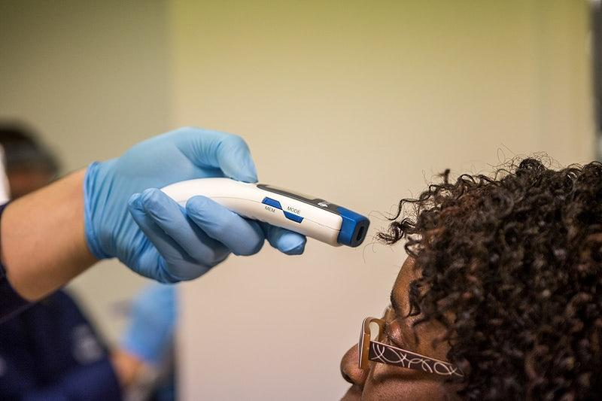
DAILY HEALTH SCREENING
These are not required for any staff, student or visitor at any grade level. However, this practice is subject to change based on updates from county health and CDPH guidance.

Slide 7
PHYSICAL DISTANCING:
Based on current California Department of Public Health guidance physical distancing is not required. However, WCCUSD schools should maximize physical distance when feasible and if it does not prevent 100% in person learning from occurring.
School Gathering/Group Meetings:
Student assemblies, special performances or student clubs recommended to meet outside if weather permits
If student based or Professional Learning Community (PLC) gatherings are conducted indoors the following Covid prevention protocols shall be followed with strict adherence:
Stay home when unwell and get tested
Proper masking
Screening testing
Handwashing and respiratory etiquette
Ventilation - keep doors and windows open
Notes:
Use theaters, multi purpose rooms or gymnasiums when possible

Slide 8
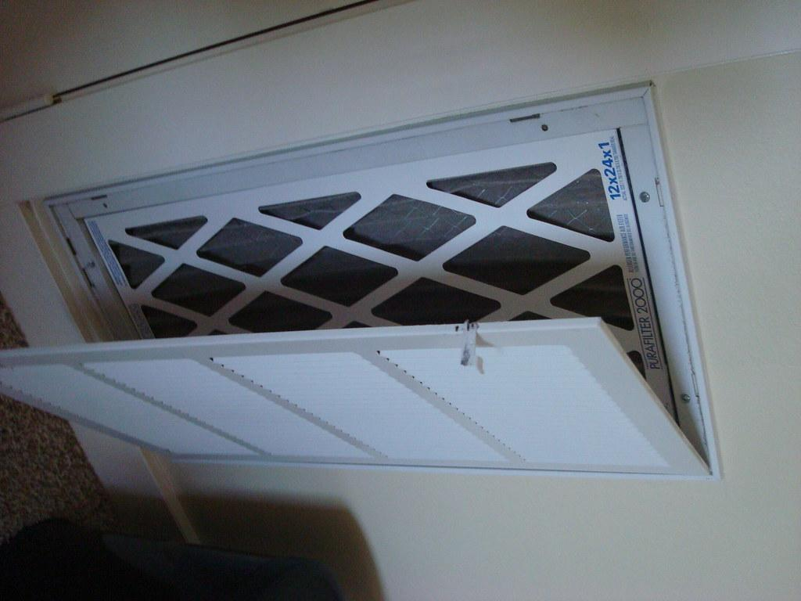
INDOOR AIR QUALITY
WCCUSD will continue to use and maintain our upgraded air filtration systems in our schools and offices including in-room air purification or Merv-13 filters in built-in HVAC systems.

Slide 9
VOLUNTEER REQUIREMENTS:
Schools and WCCUSD facilities should limit nonessential volunteers, and activities involving external groups or organizations with people who are not fully vaccinated, particularly in areas where there is moderate-to-high COVID-19 community transmission. Volunteers shall adhere to the following procedures:
Volunteers (including parents) will not be allowed on campus without approval from the site administrator and compliance with the *WCCUSD Covid prevention protocols.
Volunteers shall also submit to the normal WCCUSD Community Engagement office application/clearance process(Volunteer Services)
Any volunteer permitted on the campus must first check-in at the school office and adhere to all posted health and safety protocols
Schools should not limit access for direct service providers, but can ensure compliance with school volunteer policies.
Notes:
Vaccination verification
Or proof of recent negative Covid test results
WCCUSD Masking policy

Slide 10
RECESS AND UNSTRUCTURED TIMES:
In general, people do not need to wear masks when outdoors (e.g., participating in outdoor play, recess, and physical education activities). However, particularly in areas of substantial to high transmission levels, Staff and students are encouraged to wear mask in crowded outdoor settings or during activities that involve sustained exposure with other people. When physical education activities or recess are held indoors masking is strongly recommended for staff and students
Notes:
Equipment that has been used will be cleaned and sanitized following district sanitization procedures

Slide 11
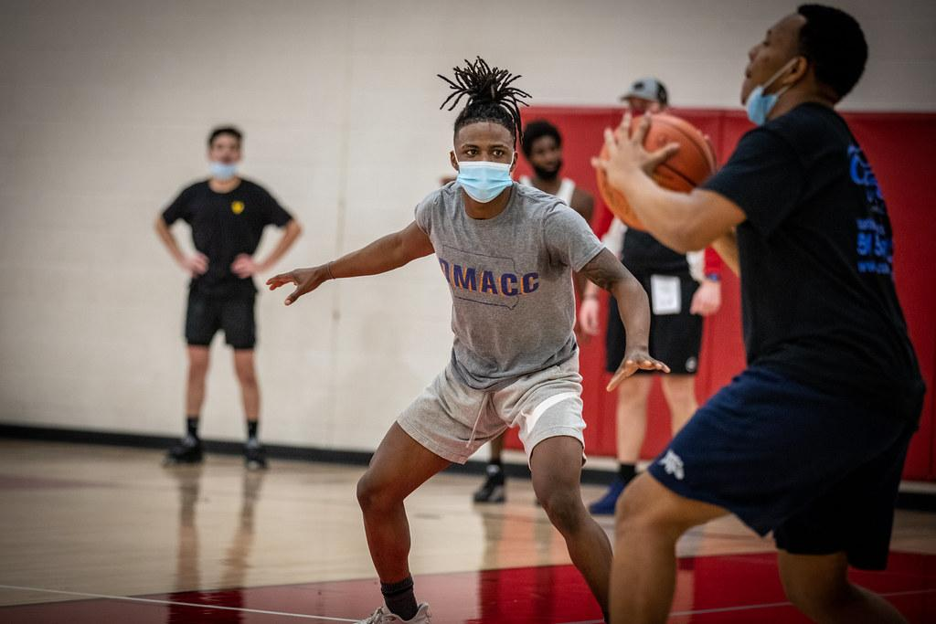
EXTRA-CURRICULAR ACTIVITIES:
There are no longer any testing requirements for youth sports but individuals should continue to wear a mask during indoor sporting events. Additional Youth Sports guidance may be provided by the California Department of Public Health.
Sports:
Indoor & Outdoor sports will continue to utilize the WCCUSD pre-screening process before practices and contest.
All Indoor Activities:
Spectators and staff regardless of vaccination status are all strongly recommended to wear a mask while indoors.
Indoor events should have good air quality and proper ventilation (ex. Open doors and windows with consistent air flow)

Slide 12
WCCUSD COVID TESTING SCHEDULE/PROCEDURES
August 16-19 and August 22-26 LSA will conduct weekly testing at all school sites
LSA will provide Group Tracing testing during the entire school year for exposed groups at all sites
Group Tracing testing will be conducted between 3-5 day from the date of expose at the school site
School sites will have at-home-test kits available for students and staff upon request
School sites will distribute at-home-testing kits to students and staff before every major school break (Thanksgiving,winter & spring break etc)
Staff and students have the option of testing with their health care provider or the County Health department, if necessary

Slide 13
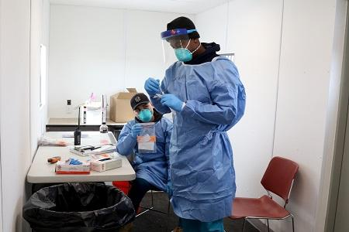
COVID TESTING OPTIONS:
LSA/GVP Laboratories Procedures:
Registration Process update
Security/Privacy Laws
Notifications
Staff Contacts
Screening Testing for students, staff and immediate family members will be at two designated locations (District and Alvarado school parking lots)Monday through Friday from 8am-4pm
At-Home Antigen test kit give away: https://www.covidtests.gov
School site distribution of At-Home Antigen test kits, as needed.
Kaiser members can also pick up at-home test kits free of charge at kp.org website
County testing location: Richmond-25th St and Nevin Ave.Mon - Fri, 8 a.m. - 3:30 p.m. Schedule online or call 833-829-2626
State testing location: San Pablo - Contra Costa College-2600 Mission Bell Dr. - Student Administration Building Cafeteria (SAB 159)Sun - Thur​, 7 a.m. - 3 p.m. and 4 - 7 p.m. Schedule online or call 833-829-2626

Slide 14
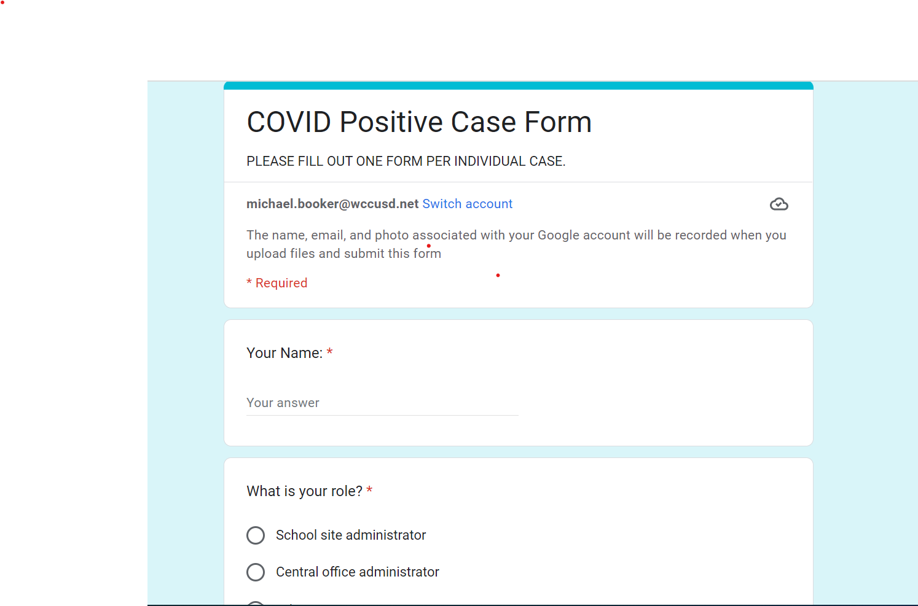
COVID GOOGLE REPORTING FORM

Slide 15
EXPOSURE
Person(s) who have spent a cumulative total of at least 15 minutes (within a 24-hour time period) in a shared INDOOR airspace (e.g. classroom) with someone with COVID-19 during their period of infectiousness.
(No longer defined as “close contact” within 6 feet of a positive case for 15 minutes or more.)

Slide 16
GROUP TRACING PROTOCOLS
Schools/Supervisors should notify all students & staff identified as exposed in the group tracing model.
Notification should occur to "groups" of exposed students/staff (e.g., classmates, teammates, cohorts, etc.) rather than individual "close contacts" (e.g. those within 6 feet). Individuals are considered exposed regardless of vaccination status and/or recent infection.
Exposed students/staff may remain in school if symptom free.
Testing required 3-5 days from exposure date. (District will coordinate testing at site, At-home test kits may also be used)
Masking required 10 days from exposure date.

Slide 17
CONTACT TRACING PROCESS
Covid Information Submission
Contact Tracing Process begins
Contact Tracing Team Receives Information
Principal Informs School Staff & Community
Site leaders gather information and submits into the Covid google form.
-CT notifies the principal after receiving case & initiates group tracing process.
-Group testing is coordinated for 3-5 days from exposure.
-CT contacts positive case for isolation instructions.
- CT submits info to County SPOT system
-PM contacts Unions
-Exposure letter sent to staff & students identified as contacts.
- Positive Case notification letter sent to school communities.
Contact Tracer (CT) is assigned case by Lead Contact Tracer.

Slide 18
CLASSROOM/SCHOOL CLOSURE CONSIDERATION:
Temporary school closures may be considered only after conferring with local health officials. There is no specific case threshold at which the State recommends an immediate temporary closure of a classroom or school. Instead, the process should be guided by local epidemiology, with particular attention paid to concern for in-school transmission. Operational factors may also be considered, including the ability to maintain sufficient teaching staff to provide in-person instruction.
Outbreak (OB) is defined as 3 or more cases connected to the same event within a two-week period. An outbreak does not constitute automatic classroom closure.
The Superintendent has full authority to shut down classrooms or schools based on outbreak severity.
WCCUSD Contact Tracers report OB to County once a 3rd case is identified within the 2 week time frame for elementary & work sites. For secondary sites, all individual cases are reported for County to identify OB due to the nature of multiple classes at secondary sites.
Further collaboration with testing and contact tracing will be done as necessary for OBs.
CDPH Website

Slide 19
SB 114 Covid Supplemental Benefit
Governor Newsom enacted SB114 on February 9, 2022. This bill, beginning January 1, 2022, until September 30, 2022, would provide for COVID-19 supplemental paid sick leave for covered employees who are unable to work or telework due to certain reasons related to COVID-19, including
the employee is attending a COVID-19 vaccine or vaccine booster appointment for themselves or a family member
experiencing symptoms, or caring for a family member experiencing symptoms, related to a COVID-19 vaccine or vaccine booster.
A full-time covered employee may be entitled to up to 40 hours of COVID-19 supplemental paid sick leave for a qualifying reason. The bill provides a different calculation for supplemental paid sick leave for a covered employee working fewer or variable hours.

Slide 20
SB 114 Covid Supplemental Benefits
This bill entitles a covered full-time employee, in addition to the COVID-19 supplemental paid sick leave described above, to take up to 40 additional hours of COVID-19 supplemental paid sick leave if the covered employee, or a family member for whom the covered employee is providing care, tests positive for COVID-19.
The bill authorizes the District to require the covered employee to submit documentation of COVID-19 testing results showing that the employee or relative tested positive and to submit to another test on or after the fifth day following the first positive test result and provide documentation of those results.
The District will require the covered employee to provide documentation of a family member’s test result before paying the additional COVID-19 supplemental paid sick leave, as applicable. Please note the District will not provide additional COVID-19 supplemental paid sick leave if the employee refuses to provide documentation of a test result.

Slide 21
Questions:

Slide 22
Process for Site Safety & Emergency Preparedness:
Step1- Develop a Site Safety Team
Identity Core Members
Engage CBO’s & Community Members
Step 2- Know the Situation
Identify Threats & Hazards
Conduct Risk Assessments
Step 3- Develop Goals & Objectives
Operational Priorities
Set Goals
Step 4- Plan Development
Develop & Analyze Course of Action
Resource Identification
Step 5- Plan Preparation, Review & Approval Process
Author Plan
Review Plan
Approve & Disseminate Plan
Step 6- Implementation & Maintenance
Train
Drill & Exercise
Review, Revise & Maintain

Slide 23
Phases of Emergency Management
Prevention-Mitigation
Preparedness
Recovery
Response

Slide 24
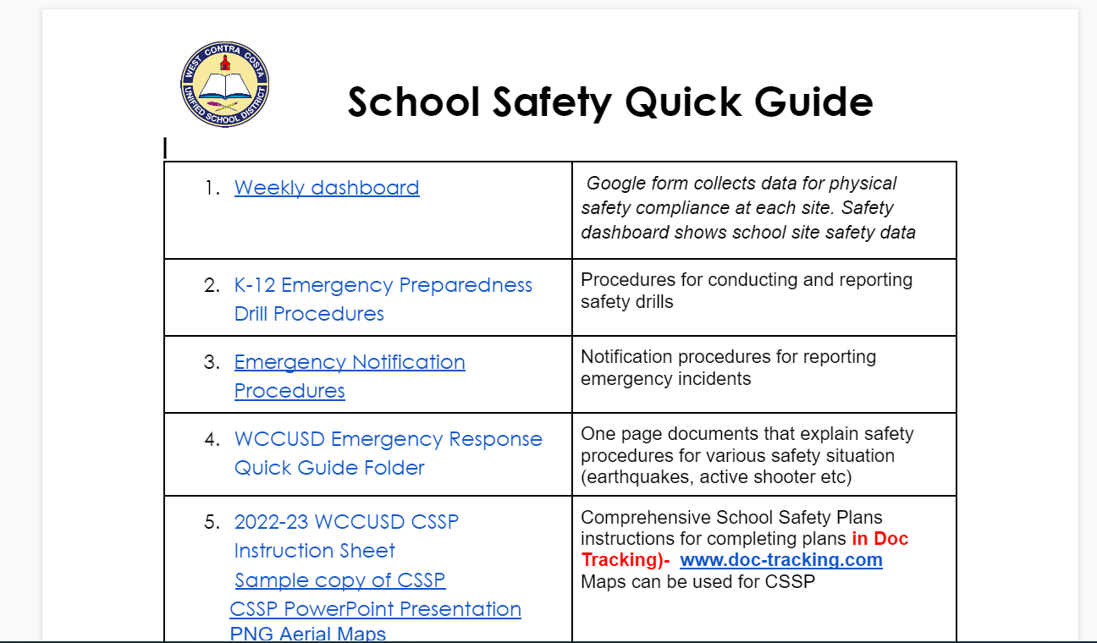
SAFETY RESOURCES

Slide 25
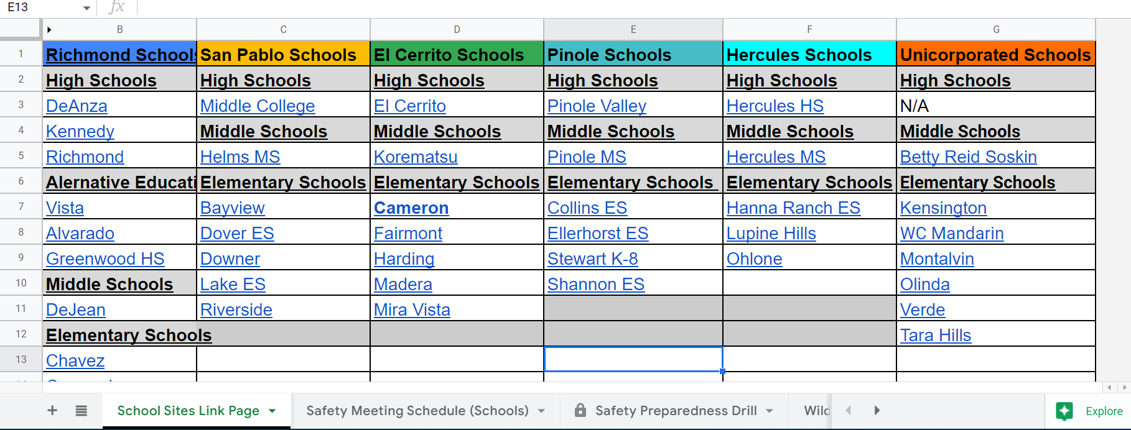
SCHOOL SAFETY TRACKER

Slide 26
WCCUSD PREVENTION STRATEGIES:
Physical Safety Plan
School Safety Procedures:
Limited points of access onto campus
Lanyard/ID procedures Identification Badge Policy
Enforce closed campus policy
Visitor sign-in procedures
Facilities assessments
Event Operational Plans
See -Something, Say Something
Talk to site admin, trusted adult, or use anonymous reporting line (800-762-7463)
Improved Site Supervision Protocols:
Campus Safety Specialist (CSS) visibility & Coverage
Campus Safety Specialist supervision
Community Based Organizations and Teacher visibility
Improved CSS-Student communication
Reduce foot traffic during school instructional hours
Updated Comprehensive Site Safety Plans
Notes:
Not a one size fits all approach (Districts/ Communities/ Schools)…..We use a layered approach towards safety
Multiple systems of support

Slide 27
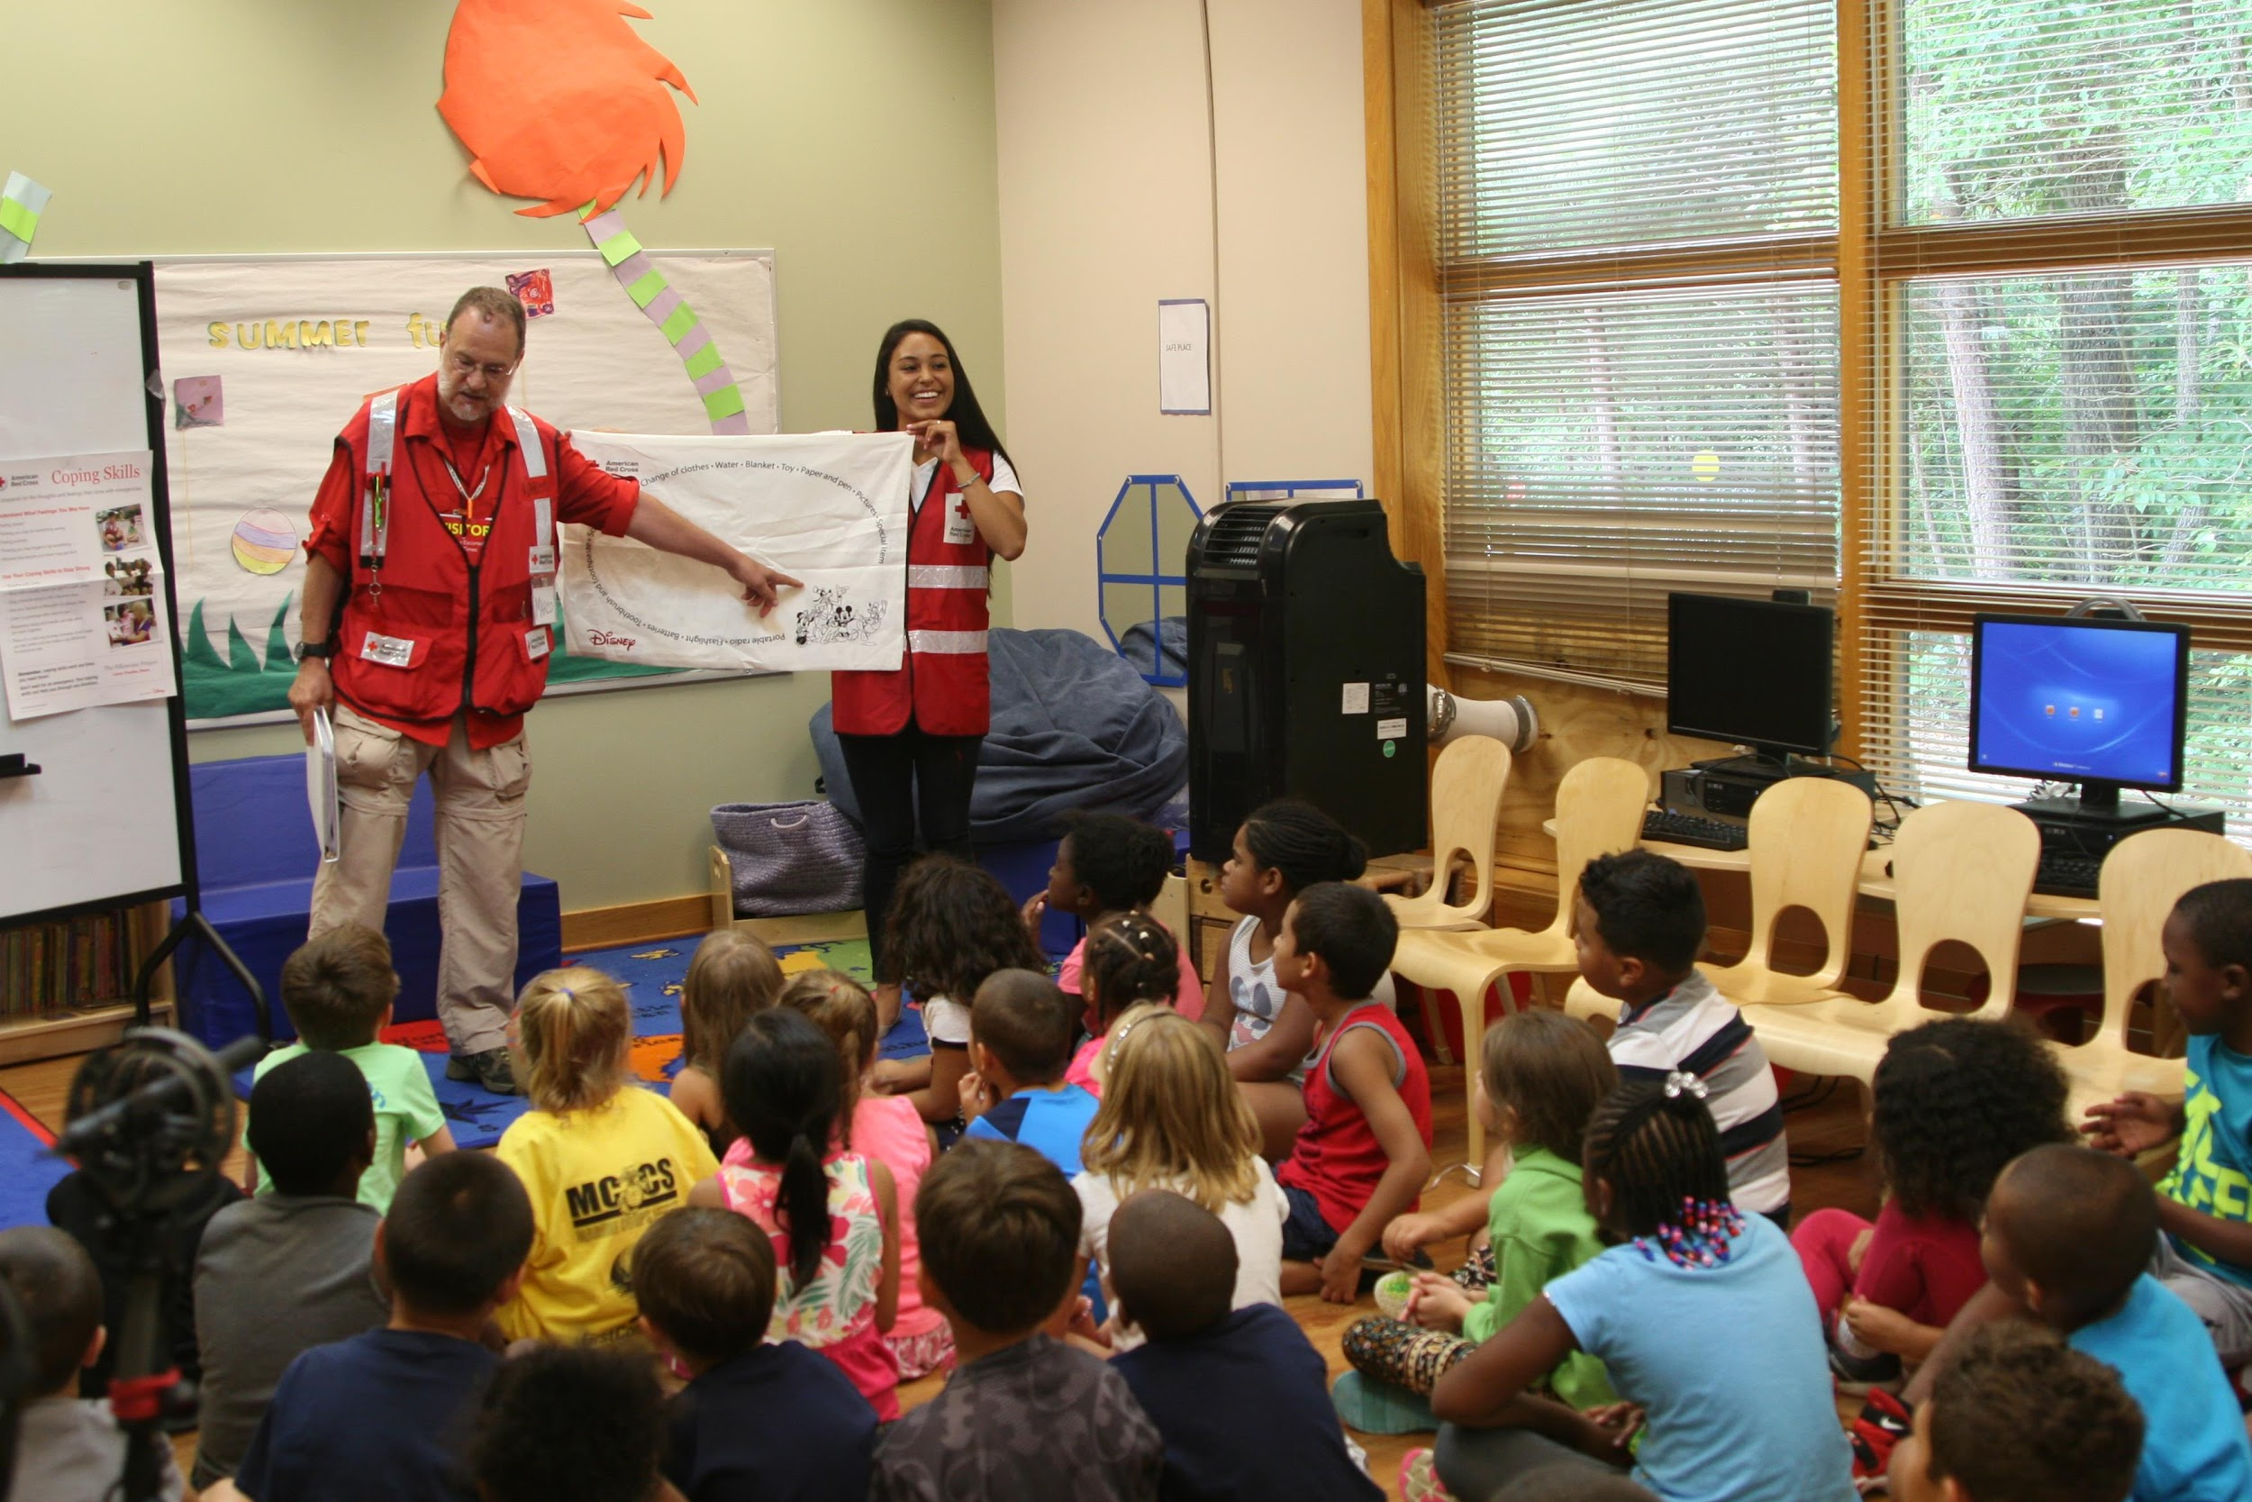
Response Actions
During an emergency, there are three primary responses:
Evacuation
Lock-down
Shelter-in-place
Response types must be used when addressing emergency situations
District personnel respond based on type of event

Slide 28
Evacuation
Evacuation is the method utilized to exit the building during an emergency event
It is similar to a fire evacuation, but there is a alternate destination
Our District Emergency Plans have provisions for relocation of students if needed
Our District Emergency Plans have provisions for reunification of students with their parents if needed

Slide 29
Lockdown
Lockdown is utilized in the event of an intruder or criminal act
Announcement is made for immediate lockdown
All building participants go to a specified locale in the room and lock doors, secure windows

Slide 30
Shelter in Place
Shelter in place is used when there is a need to minimize traffic in a hallway
It can be used when a spill occurs
It is used in a medical emergency
It can be utilized if a locker-check is needed
(School administrators, not police, check lockers)
The difference between a lockdown and shelter in place is that class continues, as usual, during a shelter in place

Slide 31
RESPONSE STRATEGIES: Physical Safety
Level 1 Emergency: i.e, student conflict, non-weapons fights (School Site Resources)
Site Leaders determine root cause for disruptions and develop a plan of action to mitigate those actions.
Level 2 Emergency: i.e., students involved in outside critical incident, student hospital, student death (District Resources)
Director or Executive Director collaborates with the site leaders to use and direct available resources
Level 3 Emergency: i.e, districtwide impact, major neighborhood crisis(Outside Agency Resources)
Director or Executive Director assists principal with coordination of safety plan rollout and liaison with outside agencies
Notes:
Power outage, contained Fire, Lockdown / suspicion of weapons
Students involved in outside critical incident (includes weekend activity)
Hospitalization (Student or staff injury requiring medical assistance), 5150
Police Activity / Student or Staff arrest
Missing student
Pandemic response (Covid-19 outbreak)*

Slide 32
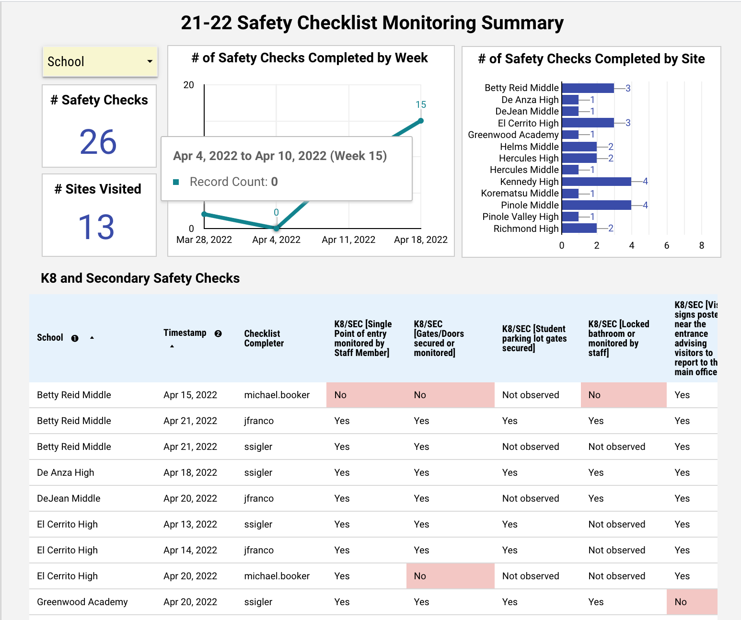
Ongoing Monitoring

Slide 33
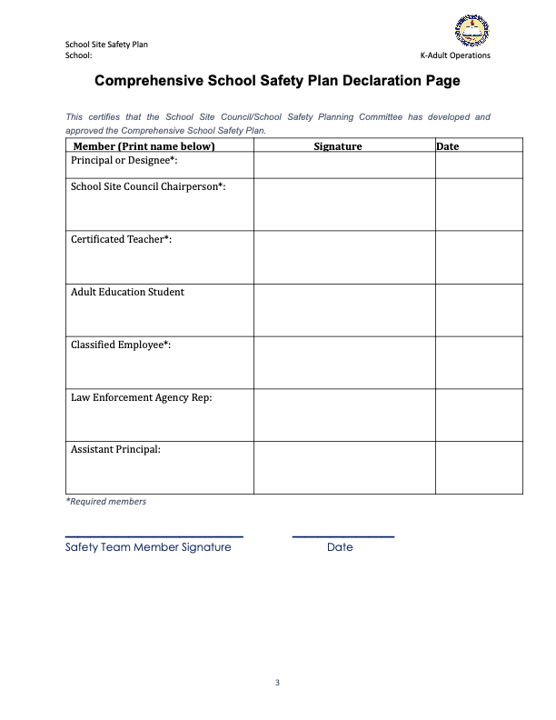
Complete Site Safety Plan:
Adhere to due dates
Review & approve Comprehensive Site Plan (Staff, SSC etc)
All staff should understand roles
Soliciting input from stakeholders(Public Safety agency, School Site Council)
Make a hard copy of CSSP for storage at site (Should be available for review if requested)
Periodic review and revision, if needed

Slide 34
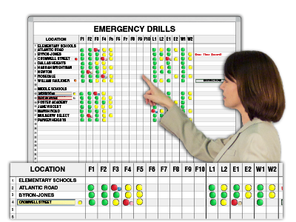
School Drill Calendar:
Automated system for reporting drill completion.
Adhere to drill procedures
Define CSS and staff role in drills
Students should have clear direction for drills

Slide 35
After-Action Briefings and Reports
Critical for capturing key lessons learned and recommendations for improvements
Help identify "what worked" and gaps and weaknesses in emergency management plans and responses
Conduct briefings at two levels
Internal-district level
External-community level
Briefings should take place shortly after an emergency response situation
Participants should include school staff, first responders, and other key stakeholders

Slide 36
Questions:
Safety Acknowledgement

Slide 37
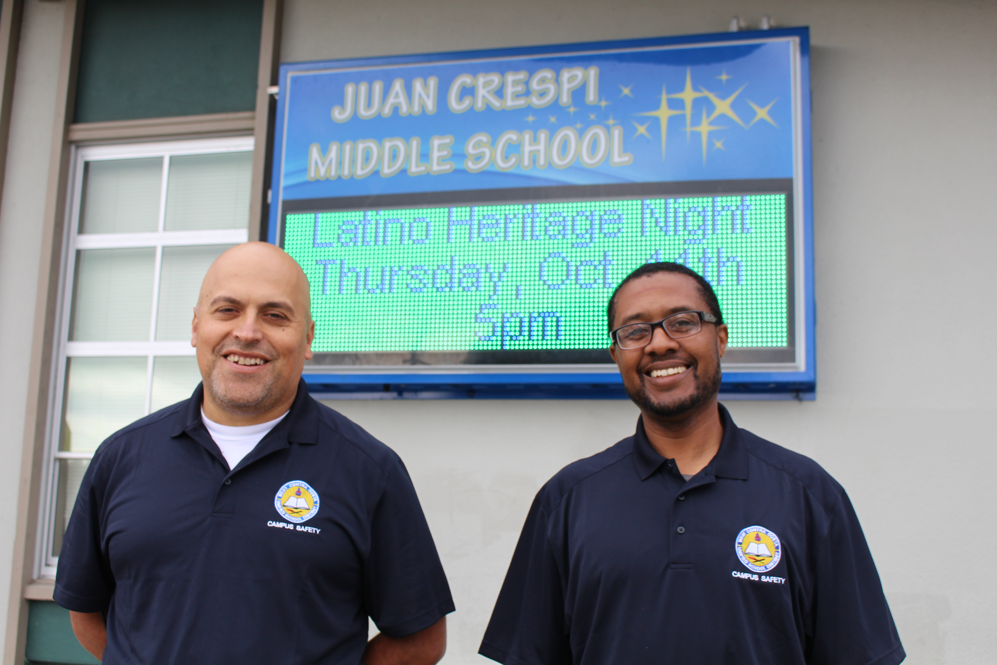
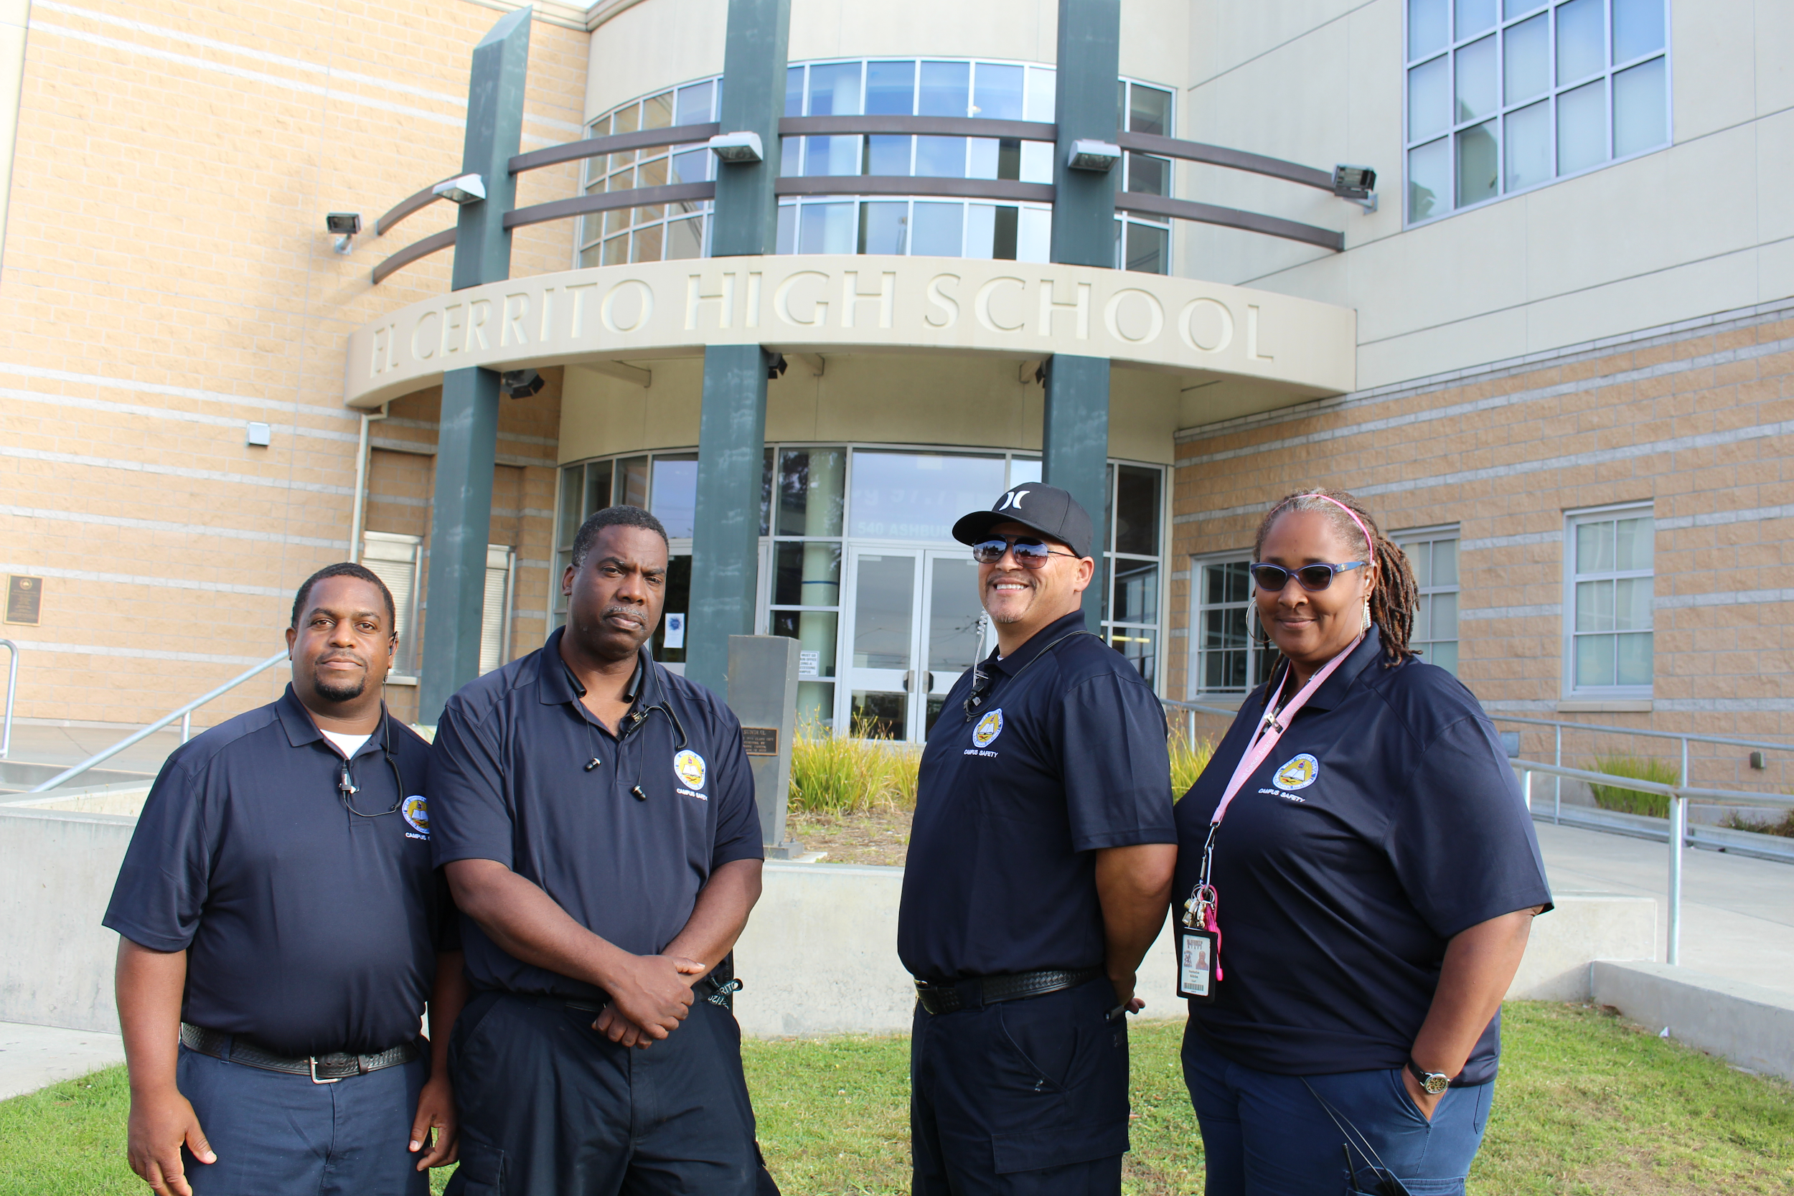
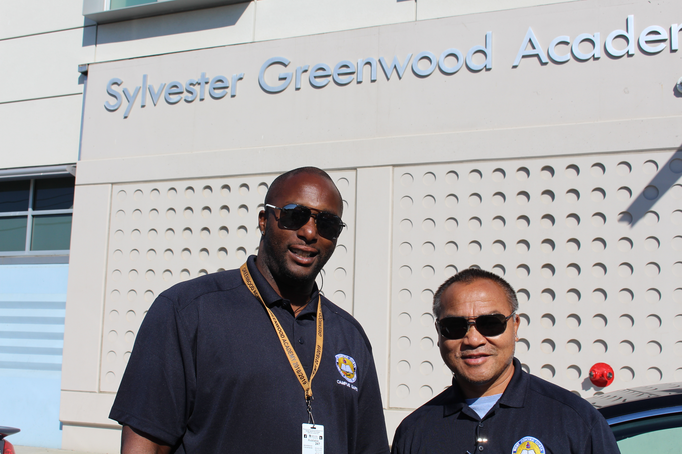
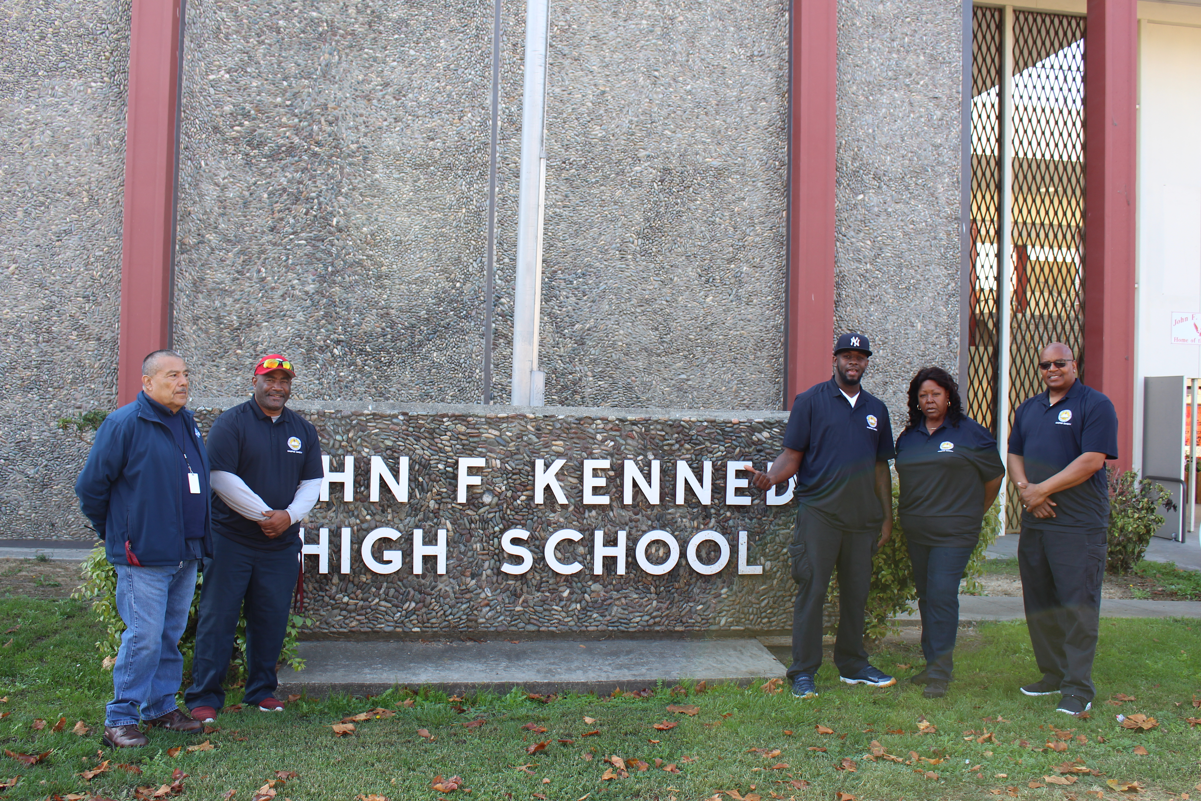
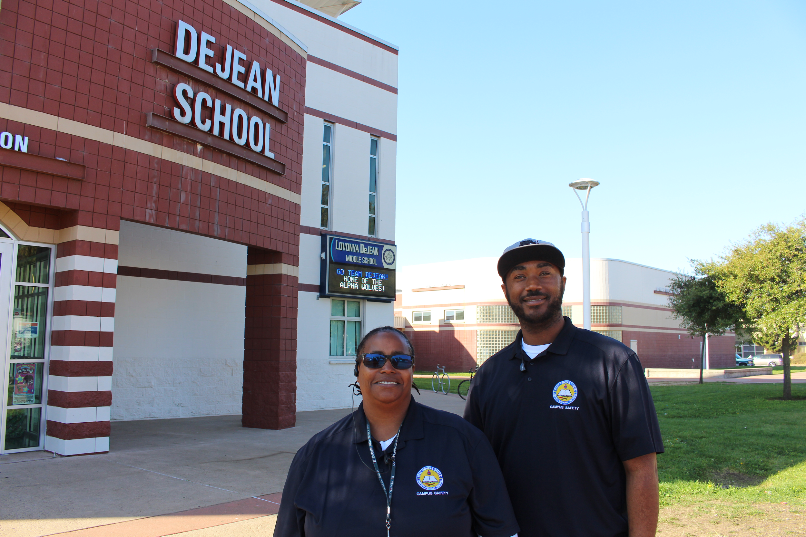
Campus Safety Specialist (CSS)

Slide 38
CSS Overview
Campus Safety Specialist Positions
CSS Supervisor
CSS II
CSS I
CSS School Locations
CSS Training
Notes:
Every high school has

Slide 39
Purpose
Campus Safety Specialists attempt to identify at-risk students and develop trusting relationships that assist in preventing inappropriate behavior. They also help monitor school halls, fields and areas around campuses that can help improve school climate and deter violence.
Questions:

Slide 40
CAMPUS SAFETY SITE SUPERVISOR
PRIMARY FUNCTION:
This is a promotional position that would be responsible for the daily and direct supervision of the CSS I & 2 assigned at the six comprehensive high schools.
This position will work directly with the site principal or their designee on the training, safety meetings and direction regarding safety and security at a site.

Slide 41
CAMPUS SAFETY SPECIALIST II
PRIMARY FUNCTIONS:
This is a elevated position that has no supervision responsibilities but is the liaison that facilitates training for the CSS on site. The CSS 2 assists in the coordination of the site safety meeting, safety drill schedule, Restorative Justice practices and the completion of the school site safety plan.
Additionally, the CSS is responsible for student supervision and asset protection as well as other duties as directed by the CSS supervisor.

Slide 42
CAMPUS SAFETY SPECIALIST I
PRIMARY FUNCTIONS:
The CSS 1 is an entry level position that is primarily responsible for student supervision and asset protection. Additionally, the CSS 1 is assigned other duties as directed by the supervisor.

Slide 43
Campus Safety Specialist (CSSs) Per Site
De Anza High School (5) Juan Crespi Middle School (3)
El Cerrito High School (5) Lovonya DeJean Middle School (3)
Hercules High School (5) Helms Middle School (3)
Kennedy High School (5) Hercules Middle School (3)
Pinole Valley High School (5) Korematsu Middle School (3)
Richmond High School (5) Pinole Middle School (3)
Greenwood Academy (3) Vista High School (1)
Adult School Lovonya Dejean (1) District Wide Rovers (4)
Adult School Richmond High (1) Total FTE CSS = 58
CSS Supervisor= 7

Slide 44
CSS Annual Training
Adolescent Mental Health Training
Basic Report Writing and
Communication Training
Cultural Diversity Training
Interpersonal Skills Training
Social-Emotional Behavior Training
Human Trafficking
Violence Prevention Training
Implicit Bias Training
School Safety and Emergency Planning
First-Aid/CPR, AED Training
Restorative Justice Training
Nonviolent Crisis Intervention (CPI)
Conflict resolution & De-escalation
Cyberbullying
Active Shooter/ Safety
School Security Training (SB 1626)

Slide 45
Questions:

